Slide 1

CBS Chatbot
Jan, Askin, Niels, Seyma, Timo

Slide 2
Table of contents
Previous Weeks
Upcoming Week
Plans & Goal
Findings & Conclusions

Slide 3
Previous week
Literature study
01
Various models
CBS
02
Discussed our progress
E-mailed research proposal
Worked on online courses

Slide 4
Upcoming week
Finishing Research plan
01
Modelling Data
Visualizing Data
03
CSV Files
04
Finding the right models
Adding metadata
Literature study
02
Linear regression
Machine Learning
Receiving CSV files
Receiving and process feedback

Slide 5
Plans & Goals
Visualizing Data
Continuing Research
Literature Study

Slide 6
Count vectors
Data matrix
 | Beste | Ik | Hoeveel | inwoners
Zin 1 | 1 | 1 | 0 | 0
Zin 2 | 0 | 1 | 1 | 1
Zin 3 | 0 | 0 | 1 | 0

Slide 7
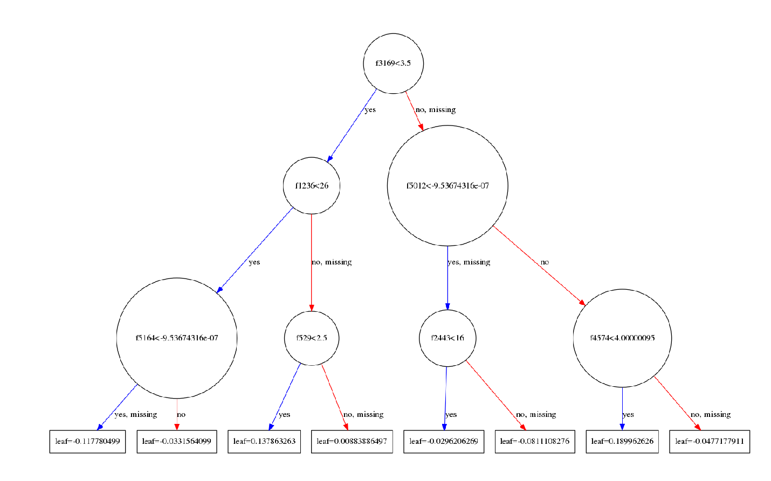
Extreme Gradient Boosting Tree

Slide 8
Example
CBS
Zoek
-0.11
-0.03
Aantal
0.13
0.008
JA
NEE
JA
NEE
JA
NEE

Slide 9
Findings & Conclusions
VISUALIZATION
KNOWLEDGE
Notes:
Extreme gradient boosting on character level SCIKit

Slide 10

Questions?

